Slide 1
Springboard Guided Capstone
Stephen McCarthy
Data Science Track Dec 2023

Slide 2
The question: Is there justification for raising prices at Big Mountain Ranch
Company
Context
Problem statement
Big Mountain Ranch is a resort style skiing destination with above average amenities for its class.
Big Sky Mountain needs to increase revenue. It has taken on additional operating costs of $1.54MM in order to increase comfort and distribution of skiers. Revenue generation can obtained by a number of different avenues including charging for parking, increasing food prices, days open, day only/night only skiing tickets, and increasing lift ticket prices
Can efforts be made to increase revenue by 20% in the next year?

Slide 3
Executive Overview
Scope of solution space
Constraints
Criteria for Success
In this project, we assume that increasing the number of days the resort is open is the best way to attract more visitors. Our secondary goal is to predict the extra days Big Mountain could be open if they make more snow on site. We'll forecast the open days each season based on overall ski resort data, considering factors like location and physical geography. However, we won't be assessing the additional cost of creating more snow, given the complexity weather introduces in estimating the needed amount for the predicted days.
Due to the lack of concrete data on the impact of ticket prices and infrastructure improvement we will need to use an industry informed approach to obtain an expected value of ticket price.
The data science team will use stats, machine learning, and business insights to suggest ways to boost revenue. They'll also predict how much money can be made in the future if these changes are made.

Slide 4
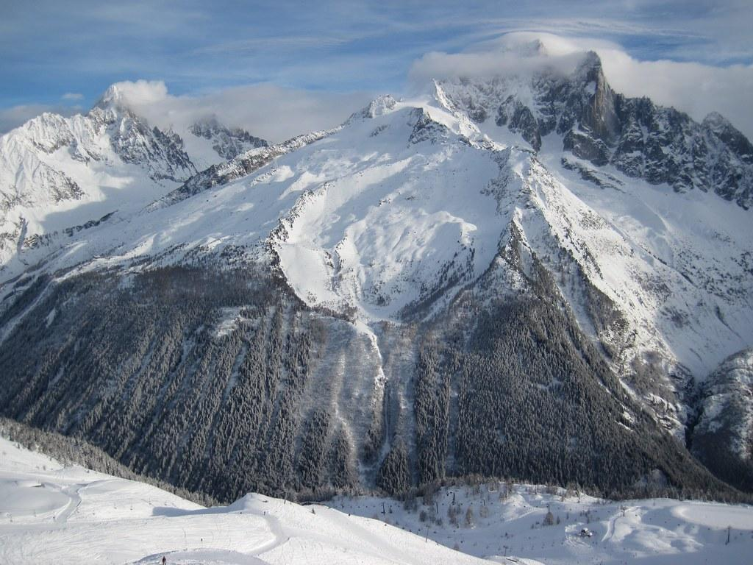
Executive Overview Continued
Key Issues:
Incomplete pricing data.
Skewed distributions and outliers in dataset attributes.
Lack of clear correlation between state and ticket price.
Recommendation and Key Findings
Recommendation: Consider raising ticket prices.
Key Findings:
Strong potential for price increase based on analysis.
Factors influencing ticket pricing identified.

Slide 5
Modeling Results and Analysis Overview
Data Quality Assessment: Addressing duplicates and missing data.
Exploratory Data Analysis (EDA): Insights into state and resort characteristics.
Model Preprocessing and Feature Engineering: Building and evaluating models.
Winning Model and Scenario Modeling: Performance and scenario outcomes.

Slide 6
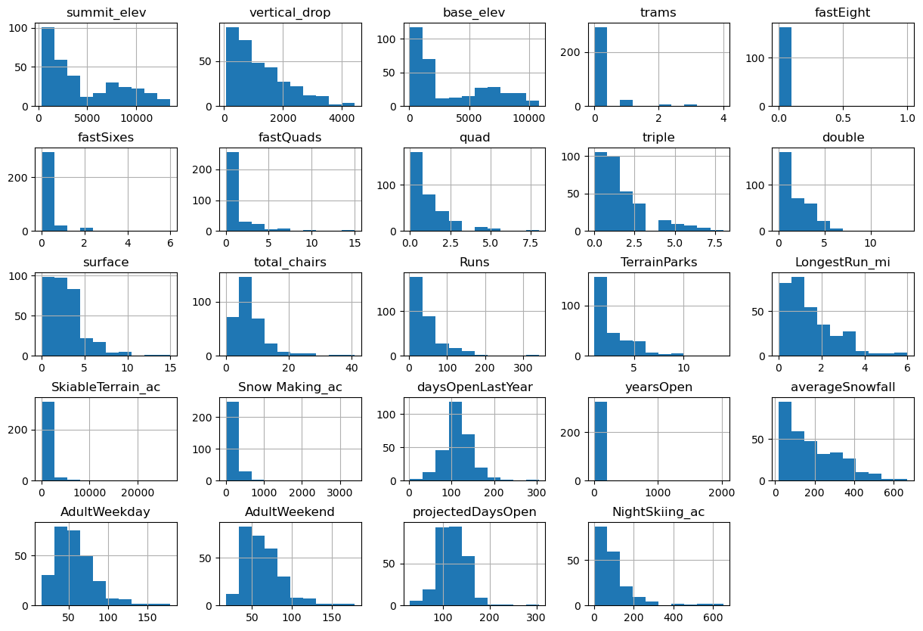
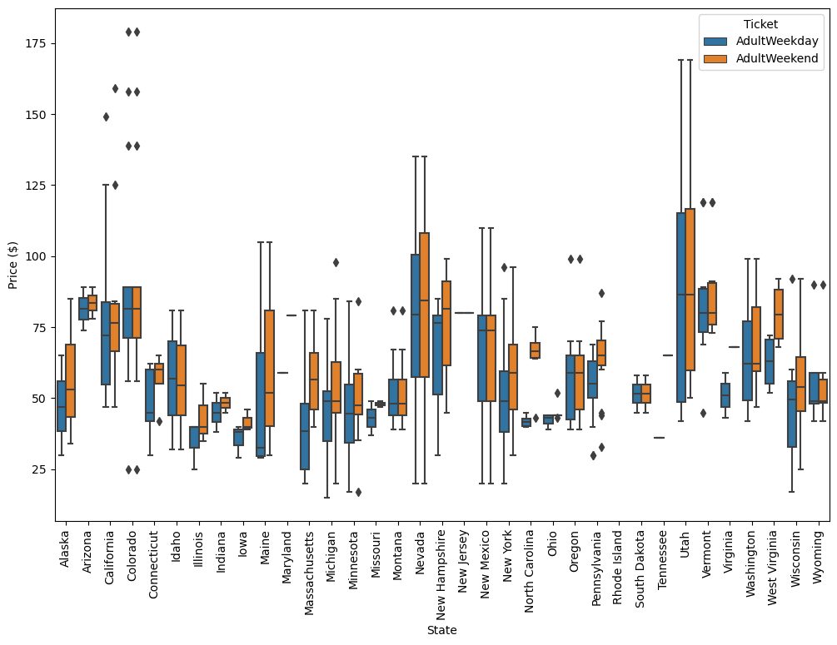
Data Wrangling
In analysing the data we found there to be a single duplicated value, some fat finger issues, and analyzed price data with respect to states in order to determine Big Mountain’s place in the overall resort world.

Slide 7
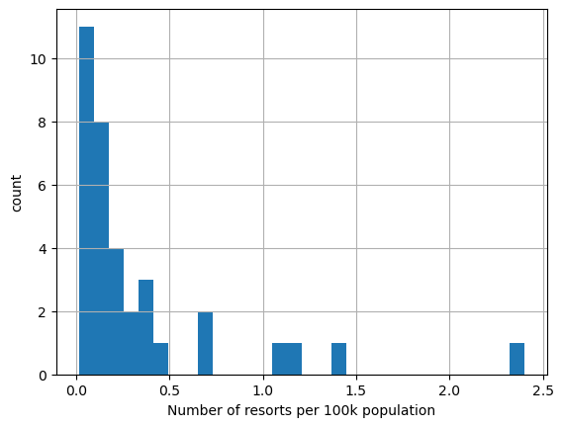
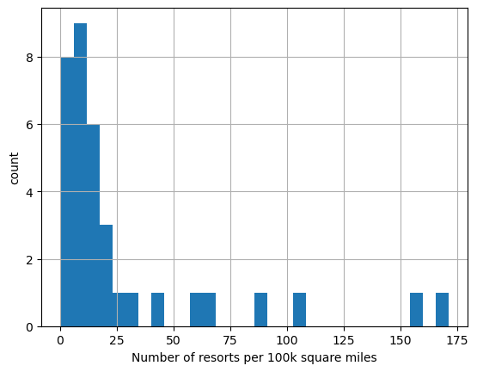
Exploratory Data Analysis (EDA)
In an effort to better understand the work we had done density of resorts was analyzed.

Slide 8
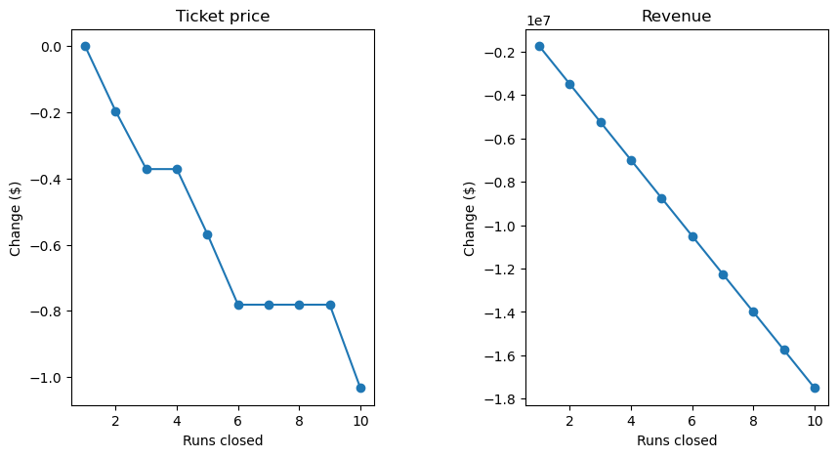
Model Preprocessing and Feature Engineering: Building and evaluating models.
Four Scenarios were tested in order to determine viability.
The base model was initially calculated using the average price which showed the ability to calculate simple metrics via brute force equations that line up with the scikit model
Also highlight that a random forest regressor was tried, what preprocessing steps were found to be best, and again what its estimated performance via cross-validation was and whether its performance on the test set was consistent with that.
The model says closing one run makes no difference. Closing 2 and 3 successively reduces support for ticket price and so revenue. If Big Mountain closes down 3 runs, it seems they may as well close down 4 or 5 as there's no further loss in ticket price. Increasing the closures down to 6 or more leads to a large drop.

Slide 9
Model Preprocessing and Feature Engineering: Building and evaluating models.
Scenario 2
In this scenario, Big Mountain is adding a run, increasing the vertical drop by 150 feet, and installing an additional chair lift.
This scenario increases support for ticket price by $0.76
Over the season, this could be expected to amount to $1329234.97

Slide 10
Model Preprocessing and Feature Engineering: Building and evaluating models.
Scenario 3
In this scenario, you are repeating the previous one but adding 2 acres of snow making.
This scenario increases support for ticket price by $0.76
Over the season, this could be expected to amount to $1329235
This makes no difference.

Slide 11
Model Preprocessing and Feature Engineering: Building and evaluating models.
Scenario 4
This scenario calls for increasing the longest run by .2 miles and guaranteeing its snow coverage by adding 4 acres of snow making capability.
The price difference was ~$0.19No difference whatsoever. Although the longest run feature was used in the linear model, the random forest model (the one we chose because of its better performance) only has longest run way down in the feature importance list.

Slide 12
Winning Model and results
max growth

Slide 13
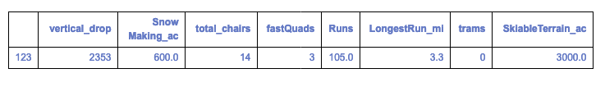
Winning Model
The random forest model has a lower cross-validation mean absolute error by almost one dollar. It also exhibits less variability. Verifying performance on the test set produces performance consistent with the cross-validation.
Impact:
Big Mountain Resort modelled price is $94.56, actual price is $81.00. Even with the expected mean absolute error of $10.42. This suggests there is room for an increase.

Slide 14
CONCLUSION
The increase in adding 2 additional acres of snowmaking in addition to another chair, higher peak and lower drop, is the same cost so it is worth the marginal ($0.76) considering the putting in both and raising the ticket prices approximately double (~$1.50) to account for possible additional parameters which aren't available.
Big Mountain offers an experience in the upper level of distributions in in skiable Terrain acerage, number of Runs, Amount of snow made, and longest run and it is > $10 cheaper than the model states for resorts in its class. A number of factors could lead to this conclusion. One in particular that no one really looked at the problem this way. Another is that management could have wanted to stay closer to the mean than charging a premium due to its location (skiiers need to travel, which is another cost which was not available).

Slide 15
FUTURE SCOPE OF WORK
Things such as employee wages, cost of materials to make snow, maintenance costs, all factor into the decision on how much to increase ticket prices. More data would make a complete picture rather than just the stuff skiiers account for. If you are bringing a family for example, lodging and amenities may have a part in the 'whole price'.
This model could be given an angular web based front end allowing business users to tinker with the effects of varying the inputs just as we have.

